Slide 1

The Flutter Ecosystem
Notes:
Hello everyone, welcome to our session on "The Flutter Ecosystem.",In this Presentation we will delve into the world of Flutter EcoSystem.We'll cover Components and their roles, Set of Libraries and Tools in Flutter, Community and Resources, Flutter’s Plugin System, Flutter’s Development EcoSystem, Flutter and Backend Services, Flutter in various Industries, Future and RoadMap and Involvements in Flutter Ecosystem.

Slide 2


Flutter Ecosystem: Components and Their Roles
Overview of the Flutter Ecosystem
  A comprehensive framework for mobile, web, and desktop app development.
Key Components
  Flutter Engine, Dart Platform, Flutter Framework, and a rich set of libraries and tools.
Role of Each Component
  How each part contributes to the functionality and efficiency of Flutter.
Notes:
The Flutter ecosystem is a robust and comprehensive framework designed for building high-quality applications across mobile, web, and desktop platforms. It's not just a UI toolkit; it's a complete suite of tools and components that work together to provide a seamless development experience.
At the heart of this ecosystem are several key components. The Flutter Engine is the underlying graphics engine that renders the UI. The Dart Platform is the programming language and runtime that powers Flutter apps. The Flutter Framework provides a rich set of pre-built widgets and tools for building your UI.
Each component in the Flutter ecosystem plays a crucial role. The Engine ensures that your app looks and feels great on every platform, providing native performance. The Dart Platform offers a modern, concise language that's optimized for UI and fast on all platforms. The Framework gives you the building blocks to construct your app's interface with ease, offering a wide range of customizable widgets.
Understanding how these components work together will give you a better appreciation of Flutter's capabilities and how it simplifies the process of app development. As we delve deeper into each component in the following slides, you'll see how Flutter's ecosystem is designed to help you build beautiful, natively compiled applications efficiently.

Slide 3
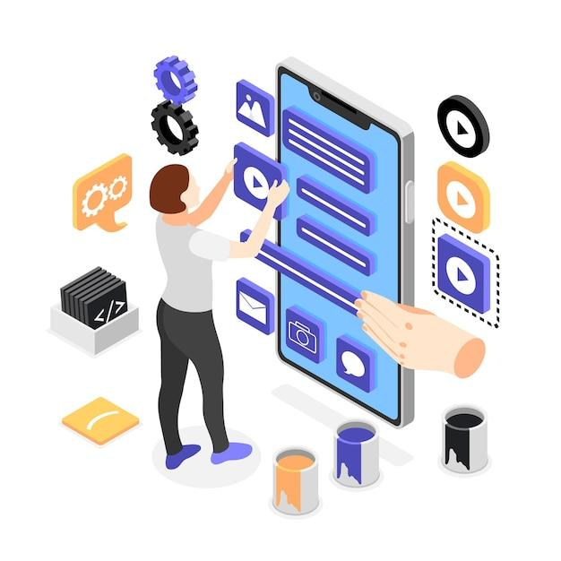
Flutter's Core Components
Flutter Engine
  The powerhouse behind Flutter's rendering and native compilation.
Dart Platform
  The modern, expressive language tailored for Flutter.
Flutter Framework
  A comprehensive collection of widgets and tools for UI development.
Notes:
The Flutter Engine is a crucial component of the Flutter ecosystem. It's responsible for rendering the user interface and handling core functionalities like graphics, text layout, and input processing. This engine, written primarily in C++, is what allows Flutter to compile to native code, ensuring that your app runs smoothly and efficiently on every platform.
The Dart Platform is the programming language chosen for Flutter. Dart is a modern, object-oriented language that is easy to learn and expressive. It's optimized for fast apps on any platform, providing a reactive framework and a rich set of libraries. Dart's unique features, such as hot reload, make the development experience in Flutter fast and enjoyable.
The Flutter Framework is the layer that you interact with the most. It provides a rich set of pre-designed widgets that make it easy to create complex UIs. The framework is highly customizable, allowing you to create bespoke widgets if needed. It also includes tools and APIs for animations, gestures, and other app functionalities. The Flutter Framework is what makes it possible to build beautiful, natively compiled applications quickly and with less code.
Together, these core components form the foundation of the Flutter ecosystem. They work in harmony to provide a seamless and efficient development experience, enabling you to build high-quality applications for any platform with ease. As we explore these components further, you'll gain a deeper understanding of how they empower you to create exceptional apps.

Slide 4

Flutter's Rich Set of Libraries and Tools
Comprehensive Libraries
  A wide range of functionalities for UI, animation, networking, and more.
Development Tools
  Streamlining the development process with tools like the Flutter SDK, DevTools, and more.
IDE Plugins
  Enhancements for popular IDEs like VS Code and Android Studio to facilitate Flutter development.
Notes:
Flutter's ecosystem is enriched by its extensive libraries, which cover a broad spectrum of functionalities. These libraries provide pre-built solutions for common tasks in app development, such as UI design, animation, networking, and data storage. This not only speeds up the development process but also ensures consistency and reliability across your applications.
The development tools in Flutter are designed to streamline the app-building process. The Flutter SDK is the primary tool, encompassing everything you need to create Flutter apps. Additionally, Flutter DevTools is a suite of performance and debugging tools that help you diagnose and fix issues efficiently. These tools are constantly evolving, with new features and improvements being added to enhance the developer experience.
Integrated Development Environment (IDE) plugins play a significant role in Flutter development. Plugins for popular IDEs like Visual Studio Code and Android Studio offer tailored support for Flutter. These include features like syntax highlighting, code completion, widget editing, and integrated debugging. These plugins make the development process more intuitive and efficient, allowing you to focus more on building great apps.
In summary, the rich set of libraries and tools in the Flutter ecosystem is a testament to its versatility and developer-friendly nature. These resources not only make app development more accessible but also more enjoyable, allowing developers to create high-quality applications with less effort and time. As you become more familiar with these tools and libraries, you'll appreciate the ease and efficiency they bring to your Flutter development journey.

Slide 5

The Flutter Community and Resources
Community Connection
Knowledge at Your Fingertips
Contribute & Grow
Always Learning
Global Events
Notes:
The Flutter community is a vibrant and supportive ecosystem, playing a crucial role in the growth and development of Flutter. It consists of developers, enthusiasts, and contributors from around the world, all sharing a common interest in Flutter. Online forums, social media groups, and platforms like Stack Overflow are bustling with discussions, advice, and shared experiences. These communities are invaluable for learning, troubleshooting, and staying updated with the latest trends and best practices in Flutter development.
In terms of resources, Flutter benefits from extensive documentation. The official Flutter website offers comprehensive guides, API references, and tutorials that are meticulously maintained and updated. These resources are designed to be accessible to developers of all skill levels, from beginners to advanced. Additionally, there's a wealth of third-party content available, including blogs, YouTube tutorials, online courses, and books, catering to different learning styles and preferences.
The Flutter community also actively contributes to the ecosystem through open-source projects, plugins, and packages. These contributions significantly expand the capabilities of Flutter, offering solutions and tools for a wide range of use cases. Engaging with the community through these projects not only enhances your learning experience but also provides opportunities to contribute back, whether through code, feedback, or knowledge sharing.
Overall, the Flutter community and the wealth of resources available are key assets that enrich your journey as a Flutter developer. They provide support, knowledge, and a sense of belonging, making the process of learning and working with Flutter a collaborative and enjoyable experience.

Slide 6
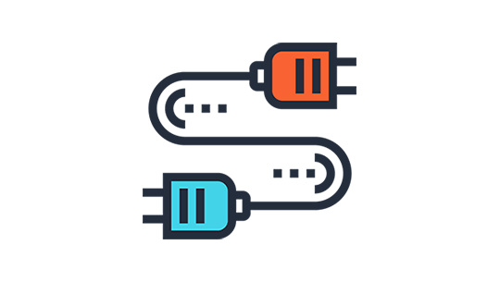
Flutter's Plugin System
Boost Your Toolkit
Native Bridge
Pick & Mix
Easy Integration
Consistent Magic
Notes:
Flutter's plugin system is a cornerstone of its functionality and flexibility. Plugins are software components that add specific capabilities to the Flutter framework, allowing developers to integrate native platform-specific functionalities into their apps. This system enables Flutter apps to access and utilize device features like the camera, GPS, and sensors, as well as third-party services and APIs.
The ecosystem is rich with a wide variety of plugins and packages, each serving different purposes. These range from simple utilities like shared preferences and connectivity checks to more complex integrations like payment processing and map services. Popular plugins include flutter_camera, google_maps_flutter, and firebase_auth, among others. These plugins are typically easy to implement, well-documented, and maintained by the community or the service providers themselves.
One of the strengths of Flutter's plugin system is its ability to bridge the gap between native development and cross-platform efficiency. By leveraging these plugins, developers can create apps that offer a native-like experience on both iOS and Android platforms without having to write platform-specific code. This not only saves time and resources but also ensures consistency in functionality and user experience across different devices.
In summary, the plugin system in Flutter is a powerful feature that significantly enhances the capabilities of your applications. It allows for seamless integration of a wide range of functionalities, making your app more robust and feature-rich. As you progress in your Flutter journey, you'll find that understanding and utilizing these plugins effectively will be key to building high-quality, versatile applications.

Slide 7
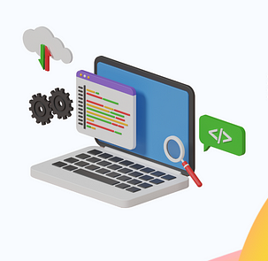
Flutter’s Development Ecosystem
Flutter SDK and Development Tools
IDE Support and Plugins
Continuous Integration and Deployment (CI/CD)
Package Management
Community-Driven Development
Notes:
The Flutter development ecosystem is designed to provide a comprehensive and efficient environment for building high-quality mobile applications. At its core is the Flutter SDK, which includes all the necessary components for developing Flutter apps. This SDK is complemented by a suite of development tools, such as Flutter DevTools, which offer valuable insights into app performance and assist in debugging.
Integrated Development Environments (IDEs) play a significant role in the Flutter ecosystem. IDEs like Visual Studio Code and Android Studio offer enhanced support for Flutter development, including features like syntax highlighting, code completion, and integrated debugging. These features streamline the development process, making it more efficient and user-friendly.
Continuous Integration and Deployment (CI/CD) is another crucial aspect of the Flutter ecosystem. Tools and services like GitHub Actions, Codemagic, and Bitrise automate the process of testing and deploying Flutter apps. This automation ensures that apps are consistently tested and deployed, reducing the likelihood of errors and improving overall app quality.
Package management in Flutter is handled through pubspec.yaml, which manages app dependencies. Developers have access to a vast repository of packages on pub.dev, which provides a wide range of functionalities and solutions for various use cases.
Lastly, the community-driven nature of Flutter development is a key strength. Developers from around the world contribute to the ecosystem through open-source projects and collaborative development. This collective effort not only enriches the Flutter ecosystem but also fosters a sense of community and shared progress among Flutter developers.
In summary, the Flutter development ecosystem is a robust and dynamic environment that supports developers at every stage of the app development process. From the core SDK to community contributions, each element plays a vital role in making Flutter a powerful and versatile platform for mobile app development.

Slide 8
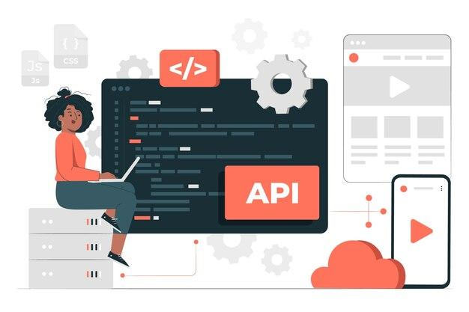
Flutter and Backend Services
Integrating with Backend Services
Seamless Data Handling
Real-Time Interactions
Security and Authentication
Scalability Considerations
Notes:
The Flutter development ecosystem is designed to provide a comprehensive and efficient environment for building high-quality mobile applications. At its core is the Flutter SDK, which includes all the necessary components for developing Flutter apps. This SDK is complemented by a suite of development tools, such as Flutter DevTools, which offer valuable insights into app performance and assist in debugging.
Integrated Development Environments (IDEs) play a significant role in the Flutter ecosystem. IDEs like Visual Studio Code and Android Studio offer enhanced support for Flutter development, including features like syntax highlighting, code completion, and integrated debugging. These features streamline the development process, making it more efficient and user-friendly.
Continuous Integration and Deployment (CI/CD) is another crucial aspect of the Flutter ecosystem. Tools and services like GitHub Actions, Codemagic, and Bitrise automate the process of testing and deploying Flutter apps. This automation ensures that apps are consistently tested and deployed, reducing the likelihood of errors and improving overall app quality.
Package management in Flutter is handled through pubspec.yaml, which manages app dependencies. Developers have access to a vast repository of packages on pub.dev, which provides a wide range of functionalities and solutions for various use cases.
Lastly, the community-driven nature of Flutter development is a key strength. Developers from around the world contribute to the ecosystem through open-source projects and collaborative development. This collective effort not only enriches the Flutter ecosystem but also fosters a sense of community and shared progress among Flutter developers.
In summary, the Flutter development ecosystem is a robust and dynamic environment that supports developers at every stage of the app development process. From the core SDK to community contributions, each element plays a vital role in making Flutter a powerful and versatile platform for mobile app development.

Slide 9

Flutter in Various Industries
Web Industry Adoption
Customizable for Specific Needs
Cross-Platform Efficiency
Enterprise-Level Solutions
Future Trends in Industry Applications
Notes:
Flutter's versatility and efficiency have led to its wide adoption across various industries. From e-commerce and healthcare to finance and entertainment, Flutter is being used to create innovative and user-friendly applications. Each industry has its unique requirements, and Flutter's flexibility allows developers to tailor apps to meet these specific needs. This adaptability is showcased in numerous case studies of successful Flutter apps across different sectors.
One of the key advantages of Flutter in industry applications is its cross-platform efficiency. With a single codebase, apps can be deployed on both iOS and Android platforms, significantly reducing development time and costs. This efficiency is particularly beneficial for businesses looking to quickly launch their products in the market.
For larger enterprises, Flutter offers scalable solutions that can handle large user bases and complex functionalities. Its ability to integrate seamlessly with enterprise systems and databases makes it a suitable choice for developing enterprise-level applications.
Looking ahead, Flutter is poised to play a significant role in future industry developments. As emerging technologies continue to evolve, their integration with Flutter will open up new possibilities for innovative applications. Flutter's continuous updates and improvements ensure that it remains at the forefront of these developments, making it an increasingly attractive option for businesses and developers alike.
In conclusion, Flutter's impact on various industries is significant and growing. Its customizable nature, cross-platform efficiency, and scalability make it an ideal choice for a wide range of industry applications. As Flutter continues to evolve, its role in shaping the future of industry-specific applications is expected to expand, offering exciting opportunities for innovation and growth.

Slide 10

Flutter’s Future and Roadmap
Flutter's Growth and Adoption
Future Roadmap and Updates
Expanding Beyond Mobile
Community and Ecosystem Evolution
Staying Ahead of the Curve
Notes:
Flutter's future looks incredibly promising, with its growth and adoption continuously on the rise. It's gaining popularity not just among individual developers but also within major companies, who are increasingly choosing Flutter for their mobile app development needs. This trend is a testament to Flutter's capabilities and its effectiveness in building high-quality, cross-platform applications.
Looking ahead, the Flutter team has a clear roadmap with planned enhancements and new features. There's a strong commitment to improving performance and the overall developer experience, ensuring that Flutter remains a top choice for app development. These updates are eagerly anticipated by the developer community and are expected to further solidify Flutter's position in the market.
One of the most exciting aspects of Flutter's future is its expansion beyond mobile app development. Flutter for web and desktop applications is already making strides, offering developers the ability to create truly cross-platform applications with a single codebase. This expansion not only opens up new possibilities for app development but also streamlines the development process, making it more efficient and cost-effective.
The community and ecosystem around Flutter are also expected to evolve and grow. The global Flutter community is already a significant force, and as more developers join and contribute, the resource base and support system will only become stronger. This growth will lead to continuous contributions and expansion of the ecosystem, benefiting all Flutter developers.
In conclusion, staying ahead of the curve in the Flutter ecosystem means embracing new technologies and trends and preparing for future developments. As Flutter continues to evolve, developers who keep pace with these changes will be well-positioned to leverage the full potential of this powerful platform. The future of Flutter is bright, and it's an exciting time to be a part of this dynamic and growing ecosystem.

Slide 11

Getting Involved in the Flutter Ecosystem
Participating in the Community
Contributing to Open Source
Continuous Learning and Development
Networking and Collaboration
Career Opportunities
Notes:
Getting involved in the Flutter ecosystem is a rewarding experience that offers numerous benefits, both personally and professionally. The Flutter community is vibrant and welcoming, with various platforms for engagement, such as online forums, social media groups, and local meetups. Participating in these communities allows you to share and gain knowledge, experiences, and best practices, enriching your development skills.
Contributing to open source is another great way to get involved. You can contribute to the Flutter and Dart repositories, or develop and share your custom widgets and packages. This not only helps improve the ecosystem but also enhances your profile as a developer.
Continuous learning and development are crucial in the fast-evolving world of Flutter. Keeping up-to-date with the latest releases and features is essential. Attending webinars, workshops, and conferences is a great way to stay informed and learn from industry experts.
Networking and collaboration are key components of being involved in the Flutter ecosystem. Building connections with other developers can lead to collaborative projects and initiatives, opening doors to new opportunities and ideas.
Finally, the skills you develop in Flutter can lead to various career opportunities. The demand for Flutter developers is growing, and the skills are applicable in a wide range of job roles. Whether you're interested in full-time positions, freelance work, or remote opportunities, Flutter development offers a promising career path.
In summary, getting involved in the Flutter ecosystem is a multifaceted journey that offers opportunities for learning, sharing, and career growth. Whether you're a beginner or an experienced developer, the Flutter community has something to offer everyone.

Slide 12
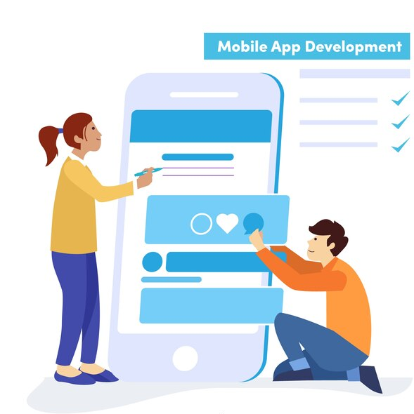
Closing Thoughts on Flutter Ecosystem
Embracing the Flutter Ecosystem
The Role of the Developer Community
Continuous Innovation and Improvement
Opportunities and Future Prospects
Notes:
As we conclude our overview of the Flutter ecosystem, it's important to recognize the comprehensive nature of Flutter and how it can be leveraged for efficient and effective app development. Flutter offers a complete package for developers, from its robust SDK and rich set of libraries to its supportive community and continuous updates.
The role of the developer community in the Flutter ecosystem cannot be overstated. Community engagement and contribution are vital for the growth and improvement of Flutter. As developers, participating in this community not only helps us learn and grow but also allows us to contribute to the development of Flutter itself. It's a collaborative effort where everyone benefits from shared knowledge and experiences.
Continuous innovation and improvement are at the heart of Flutter's philosophy. The Flutter team is committed to evolving the platform to meet the changing needs of developers and the industry. As Flutter developers, staying updated with the latest advancements and updates is crucial for making the most of the platform.
Looking at the opportunities and future prospects, Flutter opens up a world of career opportunities in app development. Its potential for innovation and creativity in app development is immense, making it an exciting field to be a part of.
In summary, Flutter stands out as a versatile and powerful tool for developers. Its ecosystem provides a supportive and dynamic environment that fosters learning, collaboration, and innovation. As you embark on your journey with Flutter, remember that you're part of a global community that's shaping the future of app development.

